Slide 1


INTRODUCTION
Name of the website
Team members:
Raghavendar
Kathin
Adithya varman
Hema harika
Navya
Vedanth

Slide 2

OBJECTIVE
The ultimate goal is to create a reliable and user-friendly website for accessing reviews of movies and anime. Unlike other platforms, this site will offer a straightforward and transparent presentation of reviews and ratings, curated by a community of dedicated movie and anime enthusiasts.

Slide 3

BACKGROUND
Developing a movie review website involves creating a platform where users can explore, review, and engage with anime and films. The aim is to provide a detailed, easy-to-navigate site that allows users to share their insights and interact with a community of like-minded movie enthusiasts.

Slide 4

Importance:
Authenticity and Trust
Community Engagement
Valuable Insights
Valuable Feedback for Continuous Improvement

Slide 5
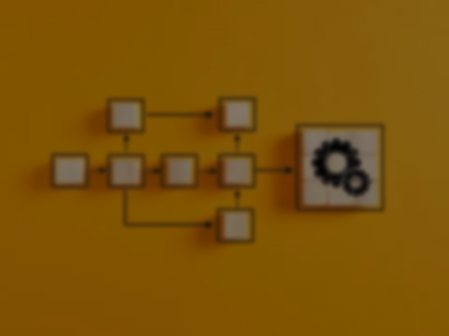
WORK FLOW:
Choosing the genres which are the most famous at present.
Creating a UI which make it easier to navigate among genres easy.
Making an ease in transition between movies and anime in the website.
Allowing users to create accounts to give reviews
Making all reviews anonymous unless selected other wise.

Slide 6


TOOLS USED
CSS HTML JAVASCRIPT

Slide 7

Attracting Initial Users
Maintaining Unbiased Ratings
Platform Security
User Retention

Slide 8

CONCLUSION:
A movie review website offers a comprehensive solution for movie enthusiasts. It provides a space for interaction, learning, and entertainment.
With growing user engagement, it can become a go-to platform for all movie-related content.

